Slide 1
WELCOME

Slide 2
Project Team
Prosenjit Das (182015030)
Minhajur Rahman Muhit (182015112)
Name: Masud Parbhez (182015109)
Afrina Jarin Kona (182015066)
Falgony Akter (182015087)

Slide 3

Presentation on E-Commerce (Online Shopping)

Slide 4
Objective
Development and implementation of a E-Commerce website for “Online Shopping".
https://anabeya.com/

Slide 5
Project Goals:
The goals of this project are to:
Design information architecture to ensure that all content and functionality are easy to use and navigate.
Design website look and feel to create a more modern, visually appealing and engaging design, that supports we mission and brand identity.
Develop new functionality based on the content management system, using a combination of HTML, CSS, JavaScript, Query, AJAX, PHP/ PHP Framework (Code Igniter,) and MySQL development. WE desired functionality includes a searchable document system web forms.
Provide site administration services, including website hosting and site statistics.
Web Security is our one of the important working part. So we ensure you a better security for your website.

Slide 6
Future Plan:
We are thinking of some modifications and adding some advanced new features in out system. Some of them are –
GUI modification (More user friendly)
Users can sell their products
Users can signup / login using their social media account such as Facebook , google+ etc.

Slide 7
Introduction
This Project are divided into two modules. This modules are -
About our system
E-commerce
About our system

Slide 8
What is E-Commerce
1. Commonly known as Electronic Marketing.
2. “It consist of buying and selling goods and services over an electronic systems Such as the internet and other computer networks.”

Slide 9
Our System
Our System is an e-commerce website from where people can buy products online.
The system is all about the converting the shopping system from manual to online.
Customer can buy products online after login to the site.
Administrator is adding product to database.
Administrator can edit or delete the products from the database.
After buying and making payment the products are send to customer’s address that he has given.
Customer can write feedback for the product or services.
Admin can see daily sell and feedback given by customer.
Administrator is adding the delivery report to the database.
Both admin and customer can see the delivery report.
Admin monitors the activity of the users and checks the transactions.

Slide 10
Main Advantage of our developments:
Responsive View
Exclusive Design
Highly Secure
Minimum Loading time

Slide 11
E-Commerce Project Stages
Stage 1: Pre stage Planning
Stage 2: E-Commerce Design & Implementation
Stage 3: Capacity building & Support

Slide 12
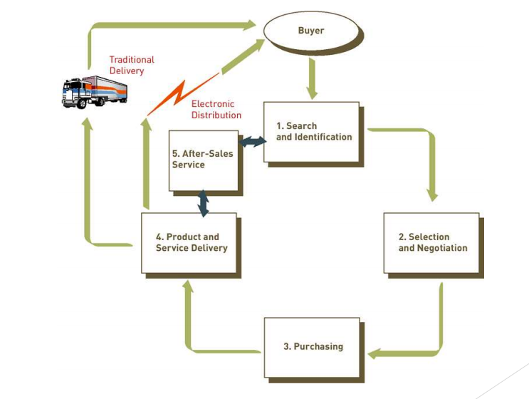
THE PROCESS OF E-COMMERCE

Slide 13
Pre-stage Planning
Requirement Analysis
Client Requirement List
Technical analysis
Data Flow Diagram
Risk Analysis
Activity Planning
Budget Preparation
Cost Benefit Analysis

Slide 14
Client Requirement List (Features):
As per development criteria, we have proposed difference features:
Administrative Panel
Customer Registration
Function of Customers
Function of Seller
Product
Shopping Cart
Checkout
Shipping
Auto generated bill
Payment gateway

Slide 15
Technical Analysis
Design Standards
Testing Standards
Delivery Standards

Slide 16
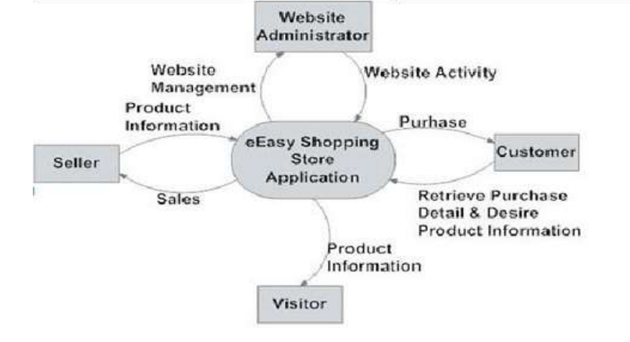
Data Flow Diagram

Slide 17
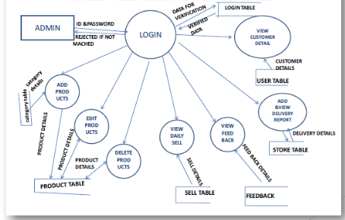
Data Flow Diagram (For Admin)

Slide 18
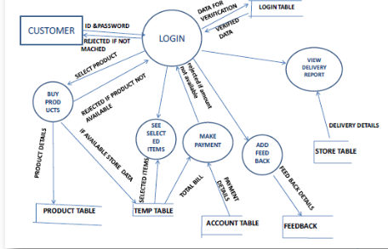
Data Flow Diagram (For Customer)

Slide 19
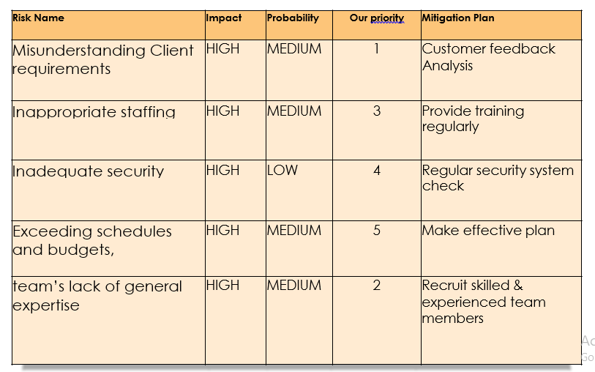
Risk Analysis

Slide 20
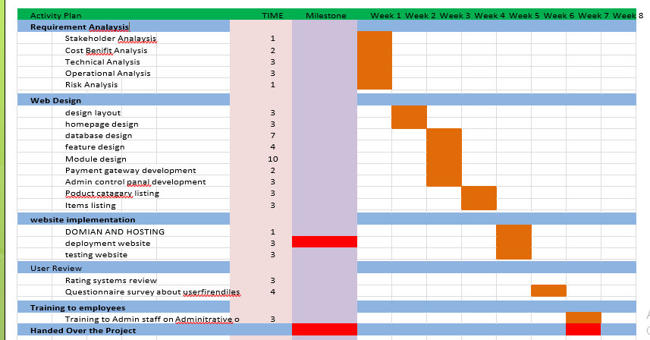
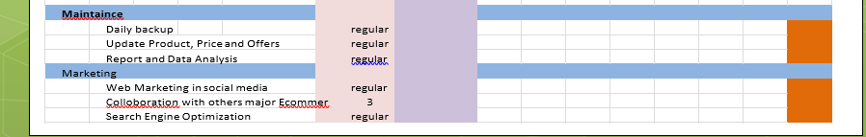
Activity Planning

Slide 21
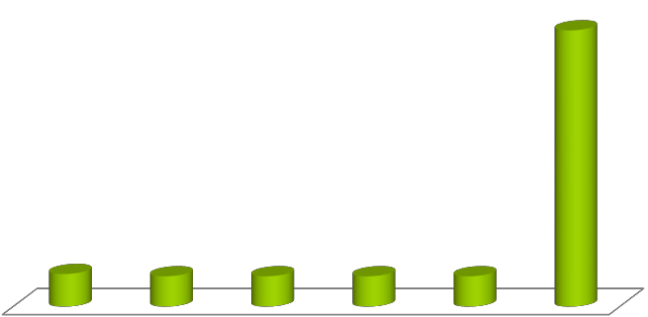
Budget Planning
140k
40k 25k 25k 25k 25k
Year 1 Year 2 Year 3 Year 4 Year 5 Total

Slide 22
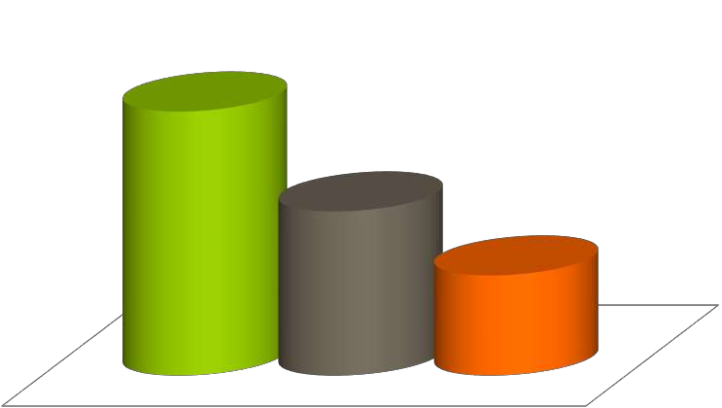
Ecommerce Cost-Benefit Analysis for 5 years
Benefit 2.5lak
Cost 1.4lak
Net Profit 50k

Slide 23

Stage 2: E-Commerce Development
Why AGILE
Light Management Process
To work in changing environments
Motivated and productive teams
Self management teams

Slide 24
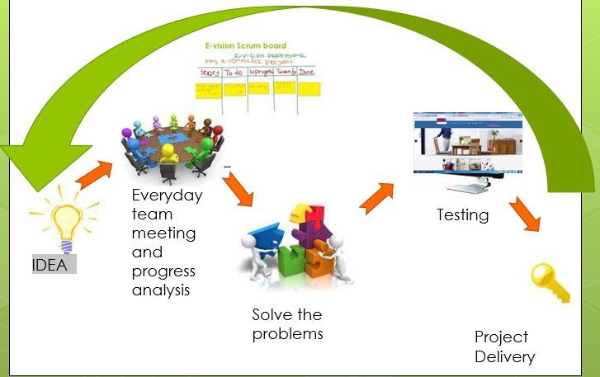
How we manage work

Slide 25

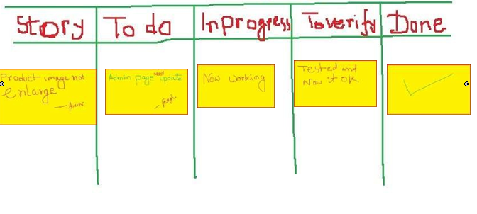
E-vision Scrum board

Slide 26
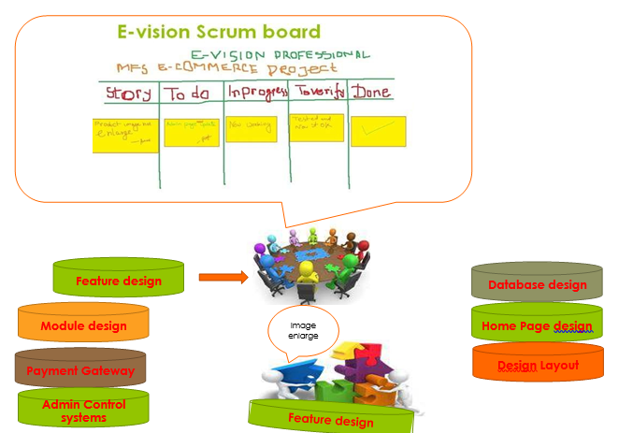
Daily Scrum

Slide 27


Slide 28

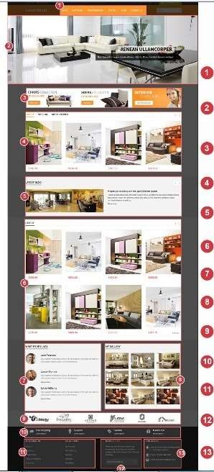

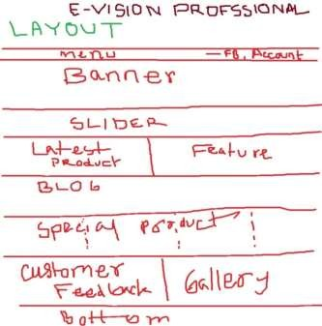



Layout Design
Client

Slide 29
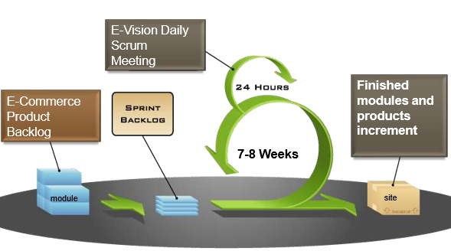
Finally Finish Process

Slide 30
GUI (Graphical User Interface)

Slide 31
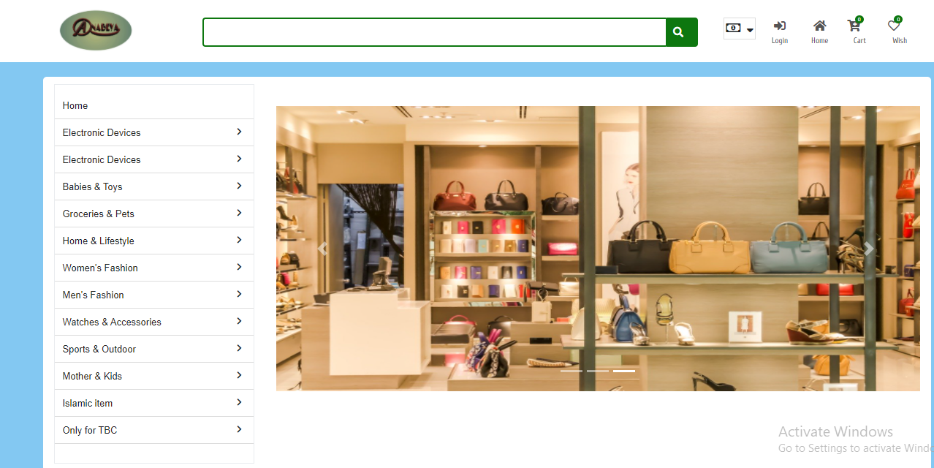
Home Page (Header Section)

Slide 32
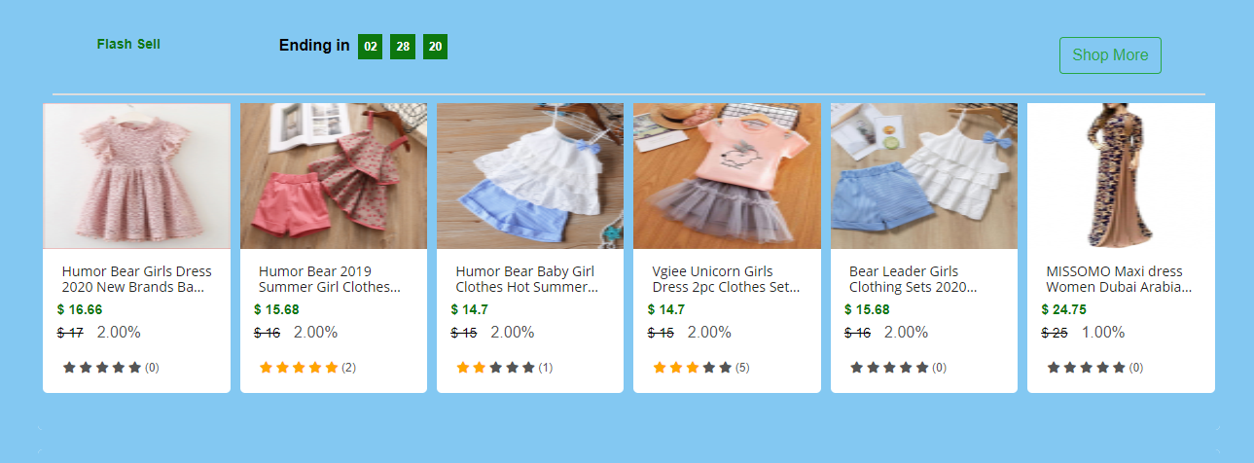
Home Page (Body Section)

Slide 33
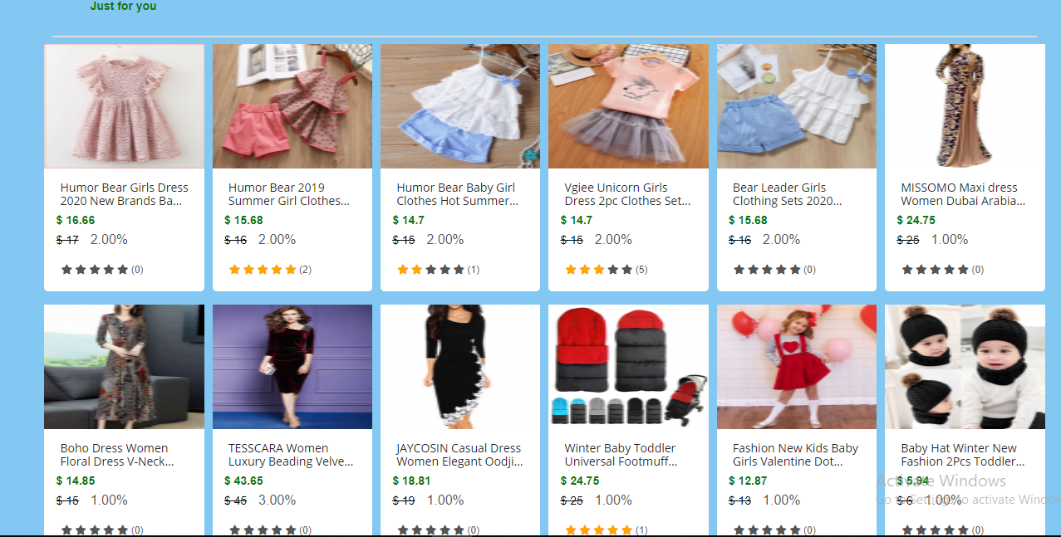
Home Page (Body Section)

Slide 34
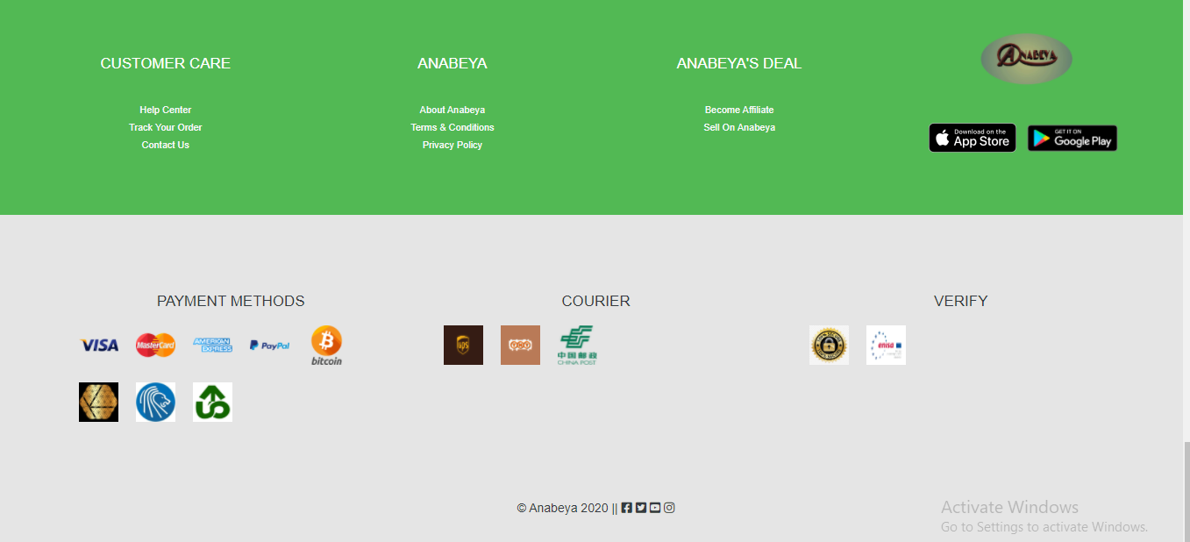
Home Page (Footer Section)

Slide 35
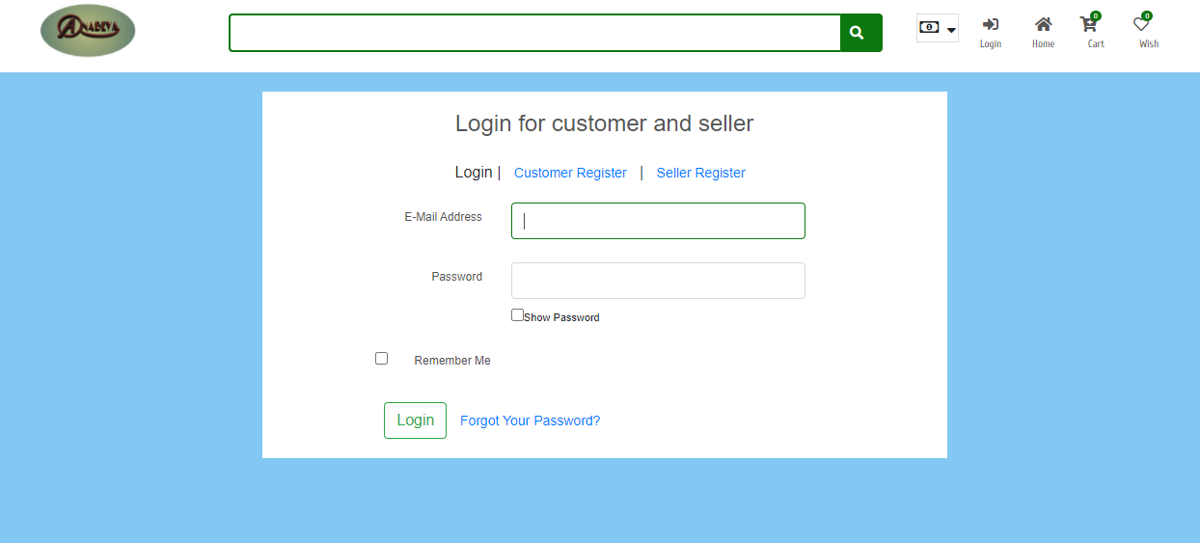
Admin Panel (Multiple Login Panel)

Slide 36
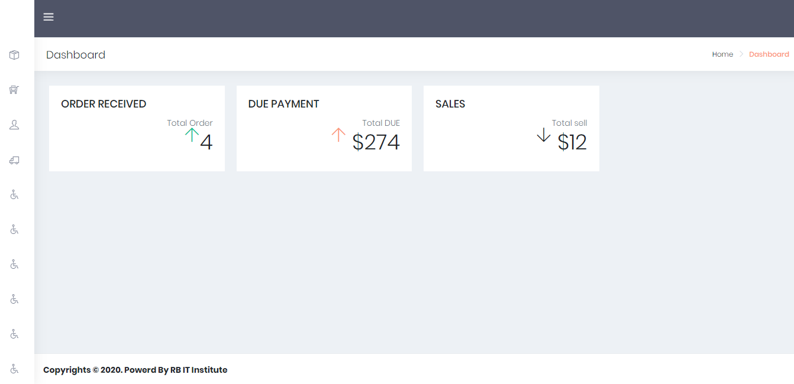
Admin Panel (Dashboard)

Slide 37
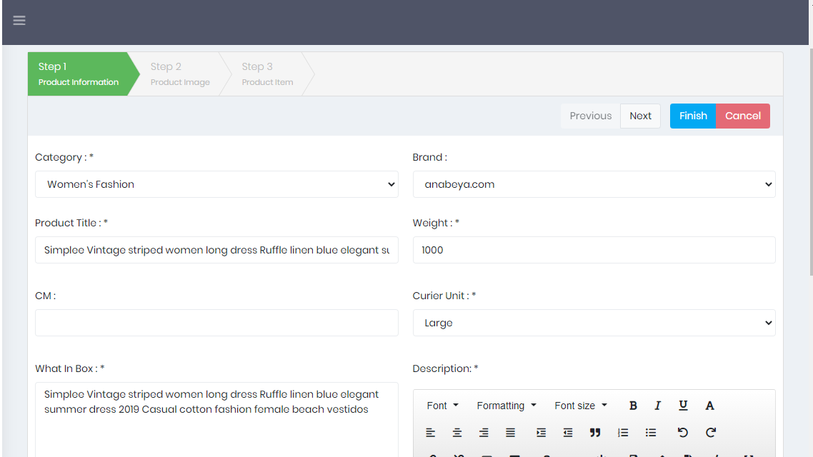
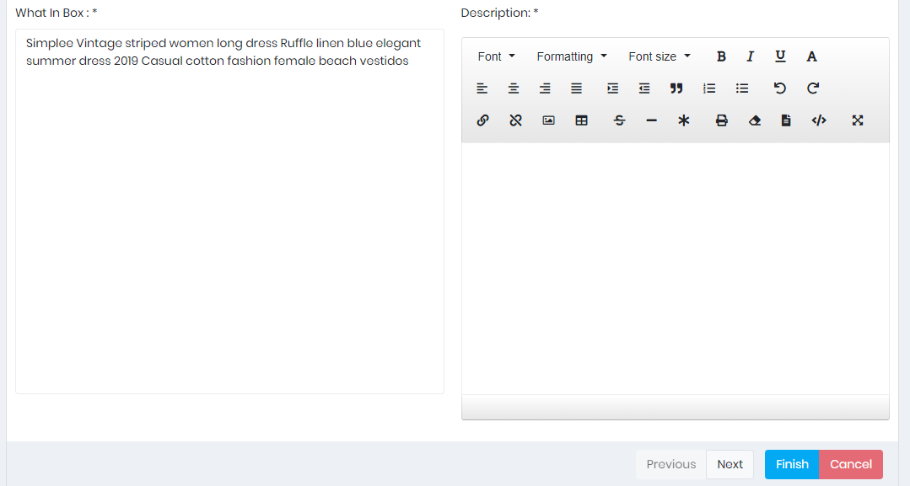
Admin Panel (Create Product)

Slide 38
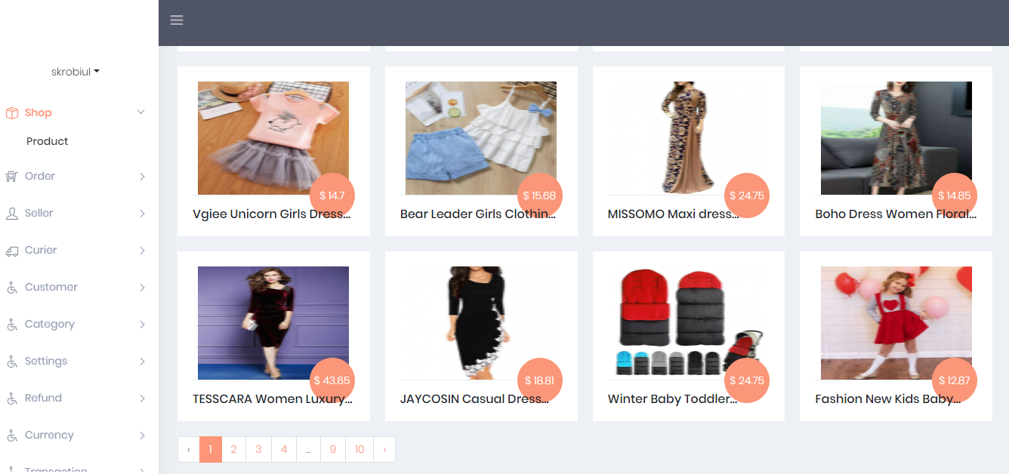
Admin Panel (Product Show)

Slide 39
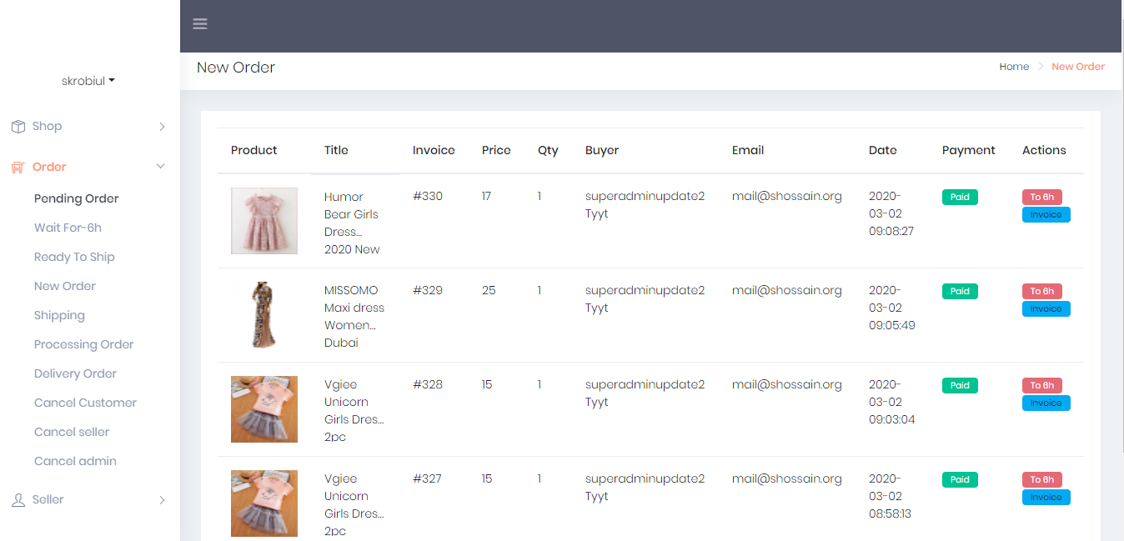
Admin Panel (Pending Order)

Slide 40
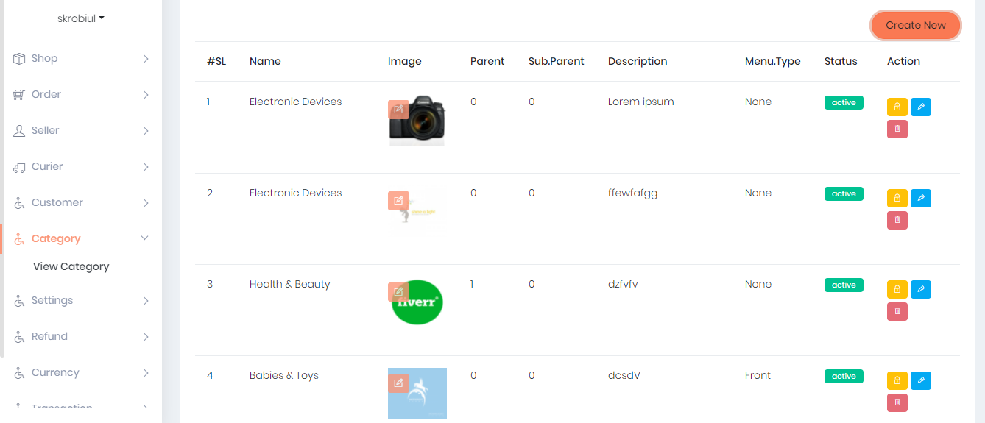
Admin Panel (View Category)

Slide 41
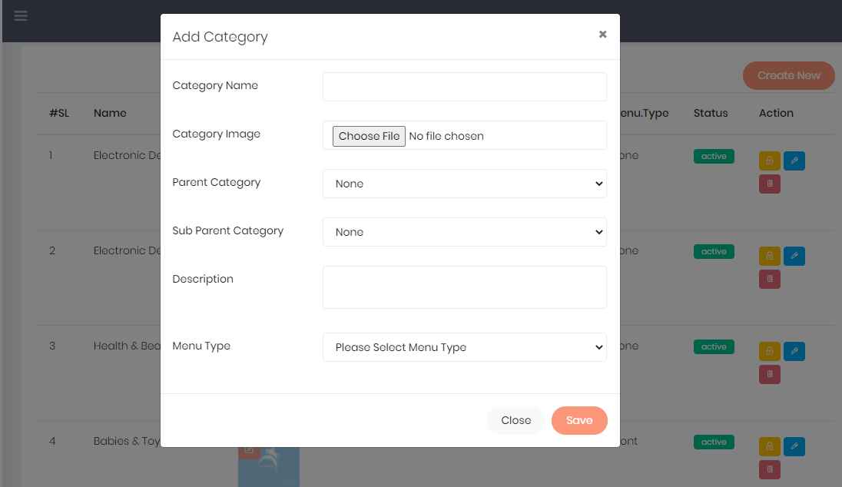
Admin Panel (Create Category)

Slide 42
Capacity Building And Support
Training to Staff
Stakeholder feedback analysis
Handing Ceremony (Commitment)
Support on maintenance, E- Marketing

Slide 43


Slide 44


